Slide 1
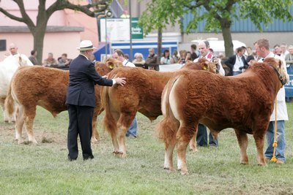
Judging Beef Cattle
Teacher
Student
Notes:
Picture:
http://www.fwi.co.uk/blogs/livestock-and-sales-blog/2008/05/

Slide 2
Teacher’s Page
Learning Objectives
  Given two pictures of different cattle, students will be able to determine which one has more muscling with 100% accuracy.
  Given two choices, students will be able to determine which one is not a leg structural problem with 100% accuracy.
  Given an external diagram of a beef cow, students will be able to locate the dewclaw with 100% accuracy.
  Given tow pictures, students will be able to determine which animal has the deepest body with 100% accuracy.
  Given two pictures, students will be able to determine which one show a bowlegged cow with 100% accuracy.

Slide 3
Teacher’s Page
Learners
  High school students in grades 9-12. The learners are in an agriculture class that focuses on animal science. Within the class, students are learning about bee cattle and how to judge them. Each of the learners will have access to a computer to use to complete this materials.

Slide 4
Teacher’s Page
Environment
  In order to complete this material, the learners will be going to a computer lab so that each one has an individual computer. The lab will be kept quiet so that each student can focus on the learning.
Go Back to Beginning

Slide 5

Why study beef cattle judging?
In this video, the importance of learning how to judge beef cattle is described. This knowledge is not only needed in the show ring, but also when raising cattle for maximum profit.

Slide 6
Menu
Judging Importance
Body Parts
Cattle Frame
Muscling
Volume
Structure
Structure cont.
Review
Quiz
References

Slide 7
I. Body Parts
Before you start judging, you must know the parts of the animal. Study this diagram to learn the parts. Be prepared for some questions on the quiz.
Notes:
http://www.sdstate.edu/ars/students/activities/judging/evaluation/upload/LivestockJudgingManual.pdf

Slide 8
II. Cattle Frame
In order to be market ready, cattle need to have a final weight in the range of 1250-1300 pounds, and a carcass weight in the range of 700-850 pounds. Other than weight, other things to look for when determining frame size is height at the top of the hip, total length of body, and the size and length of the cannon bone.
large
small
medium
Notes:
http://extension.uidaho.edu/blaine/Cindy’s%Articles/Judging%20Beef%20Cattle%20101[1].pdf

Slide 9
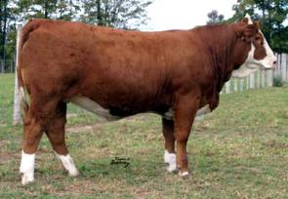
III. Muscling
The next thing to look at is the animal’s muscle mass. Essentially, the more muscle there is on the animal’s body, the meat there is. You should be able to determine the amount of muscling by looking from the animal’s backside to see how wide it is, looking at the hind quarters, looking at the top of the animal, and looking at the loin, hip, and stifle areas.
This is a good example of muscling.
Notes:
http://www.bar5.com/animals/bulls/salerika.htm

Slide 10
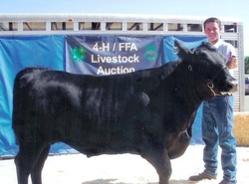
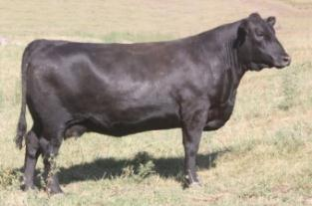
APPLY WHAT YOU JUST LEARNED!
Click on the picture that shows the correct muscling.
Notes:
Picture on the left: http://www.musclechemistry.com/upload/female-fitness-bodybuilding-31304-skinny-beef.html
Picture on the right: http://absbeef.wordpress.com/tag/beef-cattle/

Slide 11
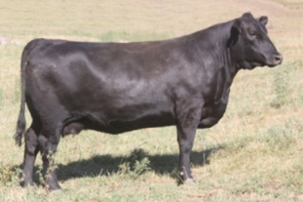
CORRECT!
This is a cow with an example of correct muscling.
Notes:
http://absbeef.wordpress.com/tag/beef-cattle/

Slide 12

GOOD TRY!
This is not a correct example because you can see the rips in this animal. You don’t want to see the ribs in a beef animal because this means they are not putting on enough weight.
ribs
Go Back To Question
Notes:
http://www.musclechemistry.com/upload/female-fitness-bodybuilding-31304-skinny-beef.html

Slide 13
APPLY WHAT YOU JUST LEARNED!
You should have chosen this picture.
Notes:
Picture on the left: http://www.musclechemistry.com/upload/female-fitness-bodybuilding-31304-skinny-beef.html
Picture on the right: http://absbeef.wordpress.com/tag/beef-cattle/

Slide 14
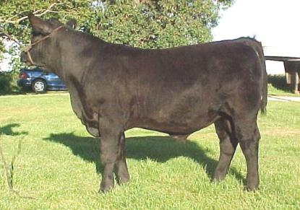
IV. Volume
In able to be the best performers, beef cattle need to be deep bodied and have a wide chest floor. These characteristics describe an animal that can eat large amounts of feed. This is an example of what these characteristics look like.
wide chest floor
deep body
Notes:
http://www.advantagecattle.com/ACSassociates/Twinoaks/herdsire1916.htm

Slide 15
V. Structure
Leg and feet placement is also very important in the production of beef cattle. Cattle can have front and rear problems with their feet and legs. Study this diagram of different types of rear leg placement.
Extremely straight
Extremely curved
Correct
bowlegged
Cow hocked
Notes:
http://www.sdstate.edu/ars/students/activities/judging/evaluation/upload/LivestockJudgingManual.pdf

Slide 16
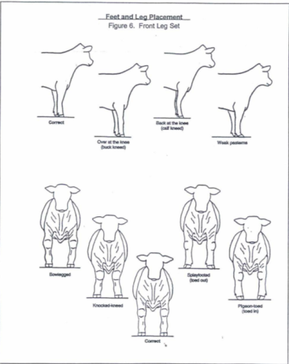
V. Structure cont.
Now that you’ve studied the rear placement, look at this diagram for the front feet and leg placement. The same rules apply to the front placement as the rear placement.
Back at the knee (calf kneed)
Correct
Weak pasterns
Over at the knee (buck kneed)
Splayfooted (toe out)
Bowlegged
Pigeon-toed (toed in)
Knocked-kneed
Notes:
http://www.sdstate.edu/ars/students/activities/judging/evaluation/upload/LivestockJudgingManual.pdf

Slide 17
APPLY WHAT YOU’VE JUST LEARNED!
If you were a farmer, why would it be important for your cattle to have good feet and leg structure?
so that the cattle can grow properly
to prevent cattle frame issues
so that cattle can reproduce without problems
all of the above

Slide 18
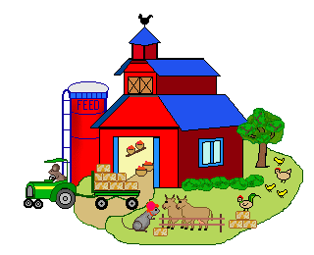
CORRECT!
You made a great choice as a farmer!
Notes:
http://bestclipartblog.com/32-farm-clip-art.html/farm-clip-art-3

Slide 19
TRY AGAIN!
Guess Again!
Go Back To Question

Slide 20
APPLY WHAT YOU’VE JUST LEARNED!
If you were a farmer, why would it be important for your cattle to have good feet and leg structure?
so that the cattle can grow properly
to prevent cattle frame issues
so that the cattle can reproduce without problems
all of the above
You should have chosen this answer because all of these qualities are needed for a good herd.

Slide 21
Review:
Watch this video to review the information before the quiz.

Slide 22
QUIZ TIME!

Slide 23
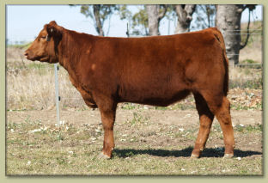
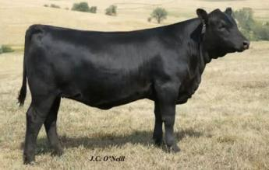
Question 1:
Click the picture that shows the cow with the most muscling.
Notes:
Good Picture: http://www.oneillangusfarm.com/fall_female_bid_off.html
Bad Picture: http://www.gklivestock.com/sales.htm

Slide 24
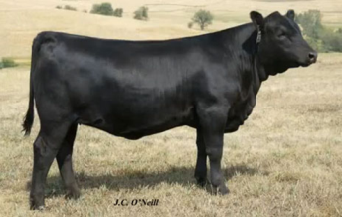
CORRECT!
This is a correct example of muscling. The heifer is very muscular throughout the shoulder and has very little fat.
good muscling
Notes:
http://www.oneillangusfarm.com/fall_female_bid_off.html

Slide 25
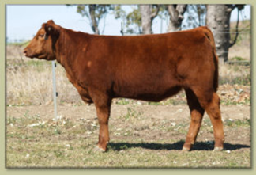
Whoops…Good Try!
This is not a good example of muscling. This heifer does not have as much muscle as the black heifer.
Go Back To Question
Notes:
http://www.gklivestock.com/sales.htm

Slide 26
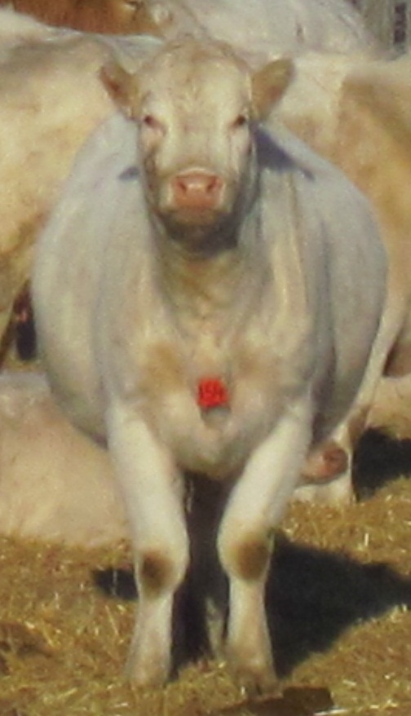
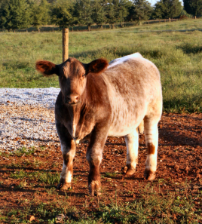
Question 2:
Which picture does not show a foot or leg problem?
Notes:
Bad Picture: http://www.stclaudevetclinic.com/pages/simple-page3
Good Picture: http://www.steerplanet.com/bb/cattle-for-sale/group-of-show-steers-for-sale-in-ky-truck-headed-to-sd-and-ia-next-week/

Slide 27

CORRECT!
This cow does not have any feet or leg problem.
Notes:
http://www.steerplanet.com/bb/cattle-for-sale/group-of-show-steers-for-sale-in-ky-truck-headed-to-sd-and-ia-next-week

Slide 28

Good Try!
This cow has a leg and foot problem called knocked-kneed.
Go Back To Question
Notes:
http://www.stclaudevetclinic.com/pages/simple-page3

Slide 29
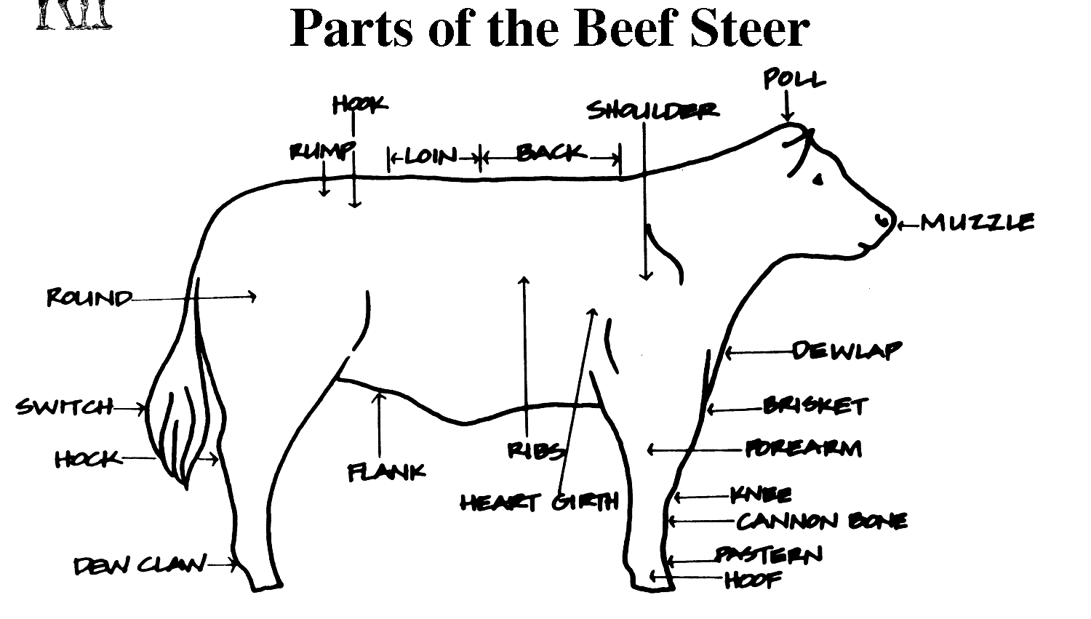
Question 3:
Click on the correct box number that is in the location of the dewclaw.
1
2
3
4
Notes:
http://www.docstoc.com/docs/52995399/Parts-of-the-Beef-Steer

Slide 30
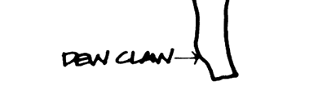
CORRECT!
You have found the correct location of the dewclaw.
Notes:
http://www.docstoc.com/docs/52995399/Parts-of-the-Beef-Steer

Slide 31
Nice Try!
This is not the correct location of the dewclaw.
Go Back To Question

Slide 32
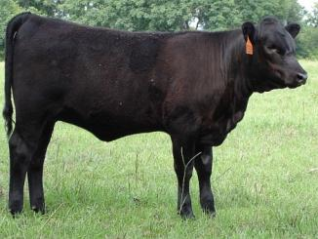
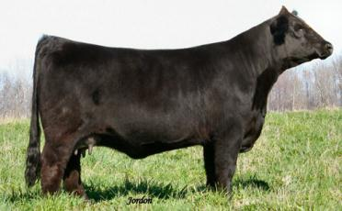
Question 4:
Which cow has the deepest body?
Notes:
Bad Picture: http://www.clemson.edu/edisto/beef/beef.htm
Good Picture: http://www.hobbsfarmscattle.com/

Slide 33
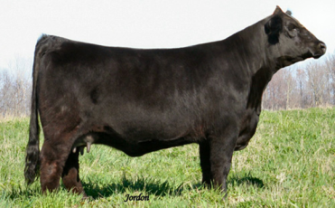
CORRECT!
This is an example of the desired body depth in beef cattle.
correct body depth
Notes:
http://www.hobbsfarmscattle.com/

Slide 34

Good Try!
This heifer does not have the desired body depth.
Shallow body depth
Go Back To Question
Notes:
http://www.clemson.edu/edisto/beef/beef.htm

Slide 35
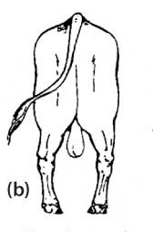
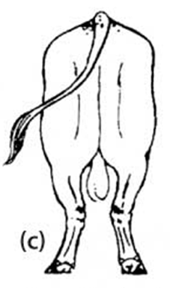

Question 5:
Which picture shows a bowlegged cow?
Notes:
http://www.brahman.com.au/technical_information/selection/structureAndLameness.html

Slide 36
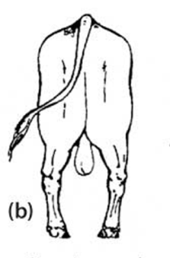
CORRECT!
This is an example of bowlegged feet and legs on a beef animal.
hooves turn in
Notes:
http://www.brahman.com.au/technical_information/selection/structureAndLameness.html

Slide 37


Try Again!
This is not an example of bowlegged feet and legs. Instead, it is an example of cow hocked feet and legs.
hooves turn outward
Go Back To Question
Notes:
http://www.brahman.com.au/technical_information/selection/structureAndLameness.html

Slide 38
References
Information
  http://www.sdstate.edu/ars/students/activities/judging/evaluation/upload/LivestockJudgingManual.pdf
  http://extension.uidaho.edu/blaine/Cindy’s%Articles/Judging%20Beef%20Cattle%20101[1].pdf
Pictures
  http://www.sdstate.edu/ars/students/activities/judging/evaluation/upload/LivestockJudgingManual.pdf
  http://extension.uidaho.edu/blaine/Cindy’s%Articles/Judging%20Beef%20Cattle%20101[1].pdf
  http://www.bar5.com/animals/bulls/salerika.htm
  http://www.musclechemistry.com/upload/female-fitness-bodybuilding-31304-skinny-beef.html
  http://absbeef.wordpress.com/tag/beef-cattle/
  http://www.advantagecattle.com/ACSassociates/Twinoaks/herdsire1916.htm
  http://www.sdstate.edu/ars/students/activities/judging/evaluation/upload/LivestockJudgingManual.pdf
  http://www.oneillangusfarm.com/fall_female_bid_off.html
  http://www.gklivestock.com/sales.htm
  http://www.stclaudevetclinic.com/pages/simple-page3
  http://www.steerplanet.com/bb/cattle-for-sale/group-of-show-steers-for-sale-in-ky-truck-headed-to-sd-and-ia-next-week/
  http://www.docstoc.com/docs/52995399/Parts-of-the-Beef-Steer
  http://www.clemson.edu/edisto/beef/beef.htm
  http://www.hobbsfarmscattle.com/
  http://www.brahman.com.au/technical_information/selection/structureAndLameness.html
  http://bestclipartblog.com/32-farm-clip-art.html/farm-clip-art-3
Video
  http://www.youtube.com/watch?v=GCLMVW522X8

Slide 39
THANKS FOR
PARTICIPATING!
Click to End

