Slide 1
?
Agriculture & Social Media:
How The Puzzle Pieces Fit Together
By Andrew Johnson

Slide 2
Social Media Outlets
Instagram – Lufkin_FFA
Twitter -@lufkinffa
Facebook – Lufkin FFA page
Remind 101- text 81010 with @lufkinffa

Slide 3
Welcome
Facebook
Lufkin FFA
Twitter
Lufkin FFA
Instagram
Lufkin_FFA

Slide 4
Table of Contents
Title Slide…………………………………………………………….. 1
Table of Contents………………………………………………… 2
What is Agvocacy?..…………………………………………….. 3
Scope of Social Media………………………………………. 4-7
About PETA and HSUS (Links)………………….............. 8
About Pro-Ag Organizations (Links)…………....... 9, 10
Animals in the News……………………………………....... 11
Animal Law……………………………………………............. 12
Social Media Impact of Agvocating................. 13, 14
Solution & Final Challenge…….…………………………… 15

Slide 5
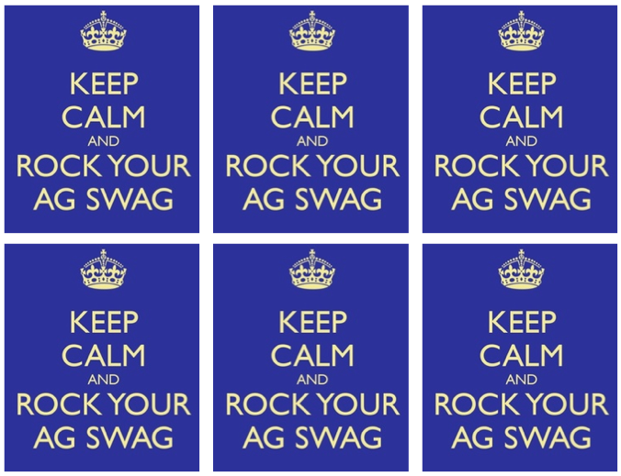
What is Agvocacy?
Agriculture + Advocacy= Agvocacy; By nature, agvocacy is the act or process of advocating or supporting an agricultural cause or proposal.
Agvocacy, or rather the lack of it, is the reason why organizations like PETA and HSUS are so well funded compared to agricultural groups.

Slide 6
Scope of Social Media
Facebook Statistics
137.6 million visitors/month (In U.S. alone)
7:45:49 = time spent/person/month on Facebook
54% of monthly users have access via mobile devices
229 = Avg. # of friends/Facebook user
Avg. # of status updates/month: 21 (Women) & 6 (Men)
On an average day:
15% of users update their own status
22% comment on another user’s post or status
20% comment on another user’s photo
26% ‘Like’ another user’s content
10% send another user a private message

Slide 7
Scope of Social Media
Twitter Statistics
Twitter has more than 140 million active users
340 million tweets are sent every day
Twitter users send 1 billion+ tweets over a 72-hr. period
126 = Avg. # of followers/Twitter user
Over 40% of Twitter users don’t tweet anything
About .05% of the tot. Twitter pop. attract 50% of the attention
71% of all tweets attract no reaction
25% of Twitter users have no followers
45% of tweets are nonsense
8% of Americans use Twitter

Slide 8
Scope of Social Media
Pinterest Statistics
3rd most popular social network (behind Facebook & Twitter)
60% female
Age group (% of user pop.): <17 (3%), 18-24 (6%), 25-34 (27%), 35-44 (29%), 45-54 (24%), 55-64 (8%), 65+ (3%)
Income level (% of user pop.): $25k-$50k (37%), $50k-$75k (33%), $75k-$100k (13%)
Over 20% of Facebook users are on Pinterest daily
Pins that have price info are just as likely to be pinned as ones that don’t, but are re-pinned more often (1.5 re-pins vs. 1.1 re-pins on avg.)
Avg. time spent on Pinterest: 14.2 min.
Buyers referred from Pinterest are 10% more likely to buy something and spend an average of 10% more than visitors from other social networks
Biggest nations on Pinterest (% of user pop.): U.S. (almost 50%), India (4.4%), and Canada (3.6%)

Slide 9
Scope of Social Media
YouTube Statistics
106.7 million visitors/month
1:41:27 = time spent/person/month on YouTube
Avg. # of views/day on YouTube: 4 billion
Mobile & Apps Statistics
42% of mobile users share multimedia via Facebook
Google+ is the 2nd-most used social network for sharing multimedia via mobile device (10%)
Smartphone owners now spend as much time using social network apps (i.e. Facebook, Twitter, etc.) as they do playing games
Avg. # of min./day apps are used on smartphones: 77

Slide 10
About PETA and HSUS
People for the Ethical Treatment of Animals: http://www.peta.org/about/default.aspx
The Humane Society of the United States: http://www.humanesociety.org/about/overview/

Slide 11
Pro-Ag Organizations
National FFA Organization
https://www.ffa.org/About/Pages/default.aspx
Texas FFA Association
http://www.texasffa.org/about.aspx?ID=2
Texas FFA Foundation
http://www.texasffafoundation.org/about.aspx
Vocational Ag Teachers Association of Texas (VATAT)
http://www.vatat.org/page.aspx?ID=151
Texas Proud of Texas Agriculture
http://texasproudoftexasag.org/about.aspx

Slide 12
Pro-Ag Organizations
Texas 4-H
http://texas4-h.tamu.edu/learn
TAMU AgriLife Extension Service
http://agrilifeextension.tamu.edu/about/
Texas Department of Agriculture
http://texasagriculture.gov/Home/AgencyInformation.aspx
Texas Farm Bureau
http://www.texasfarmbureau.org/aboutus.aspx
American Farm Bureau
http://www.fb.org/index.php?action=about.home

Slide 13
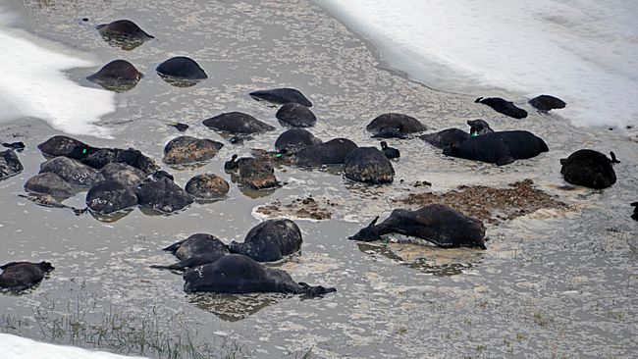
Animals in the News
Article Title:
HSUS Contributes $2,000 to South Dakota Blizzard Relief
Link: http://www.humanesociety.org/news/news_briefs/2013/10/hsus-contributes-to-south-dakota-relief-fund-10232013.html
Summary:
HSUS donated $2,000 to the Black Hills Disaster Recovery Relief Fund to aid the South Dakota ranchers who were blindsided by unexpected and unseasonable blizzards that wiped out as many as 20,000 head of cattle across the state.

Slide 14
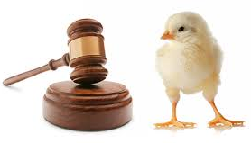
Animal Law
Legal Issue:
Tennessee’s Livestock Cruelty Prevention Act (HB 1191/SB 1248)
Summary
The LCPA, like the other so-called ‘ag gag’ bills, would have required individuals possessing recorded evidence of farm animal abuse to present it to law enforcement authorities within 48 hours. Animal rights groups like PETA and HSUS oppose ‘ag gag’ legislation because it doesn’t give them enough time to record months-worth of damning evidence of the abuse, edit it to make it look worse, and then leak it to the media. That 48-hour window would have done more to help the farm animals than PETA or HSUS’s undercover whistleblowers will ever do because from that point forward, they wouldn’t have been exposed to continual abuse. The LCPA wouldn’t have helped farmers hide anything, just prevent crazy PETA and HSUS spies from being hired under false pretenses! Unfortunately, Gov. Bill Haslam vetoed the bill earlier this month, so Wayne Pacelle, Ingrid Newkirk, and their little minions can continue to wreak havoc on Tennessee farmers.

Slide 15
Social Media Impact (Facebook)
^{(***As of June 8, 2013***)}
# of users that have ‘Liked’ page (avg. # of friends per user) = # of impressions made
HSUS 1,725,344 (229) = 395,103,776
PETA 1,738,483 (229) = 398,112,607
National FFA Organization 199,867 (229) = 45,769,543
Texas FFA Association 20,468 (229) = 4,687,172
Texas FFA Foundation 2,304 (229) = 527,616
VATAT 1,304 (229) = 298,616
TX Proud of TX Agriculture 1,250 (229) = 286,250
Texas 4-H 4,749 (229) = 1,087,521
TAMU AgriLife Extension 5,050 (229) = 1,156,450
Texas Dept. of Agriculture 3,732 (229) = 854,628
Texas Farm Bureau 8,083 (229) = 1,851,007
American Farm Bureau 4,933 (229) = 3,419,657
Total for HSUS & PETA: 793,216,383 impressions per post
Total for Team Agriculture 59,938,460 impressions per post
793,216,383/59,938,460 = more than 13x the social media reach!!!!

Slide 16
Social Media Impact (Twitter)
^{(***As of June 8, 2013***)}
# of users that follow account (avg. # of followers per user) = # of impressions made
HSUS 193,397 (208) = 40,226,576
PETA 391,346 (208) = 81,399,968
National FFA Organization 27,063 (208) = 5,629,104
Texas FFA Association 3,599 (208) = 748,592
Texas FFA Foundation 945 (208) = 196,560
VATAT 601 (208) = 125,008
TX Proud of TX Agriculture 83 (208) = 17,264
Texas 4-H 1,476 (208) = 307,008
TAMU AgriLife Extension 2,556 (208) = 531,648
Texas Dept. of Agriculture 5,496 (208) = 1,143,168
Texas Farm Bureau 9,797 (208) = 2,037,776
American Farm Bureau 20,199 (208) = 4,201,392
Total for HSUS & PETA: 121,626,544 impressions per tweet
Total for Team Agriculture 14,937,520 impressions per tweet
121,626,544/14,937,520 = more than 8x the social media reach!!!!

Slide 17
Solution & Final Challenge
The only way we can bridge the gap in terms of reach on social media is by being vocal, telling consumers the truth, and refusing to allow misinformation spread by groups like PETA and HSUS steer them away from the industry they’d be naked, hungry, sick (and probably dead) without!
Tweet or update your Facebook status once or twice a week, or everyday if you want with one reason why agriculture is important to you and the rest of the world. Go to the PETA and HSUS Facebook pages and Twitter accounts and start a debate. My final challenge to all of you is for you to make ‘agvocating’ a part of your daily or weekly routine!

